Slide 1
Women and the elderly population in social labor relations in Colombia
Andrea Paola García Ruiz
Economist, Master in Latin American Political Studies
Universidad Nacional de Colombia
apgarciar@unal.edu.co
September, 2019
Notes:
Este

Slide 2
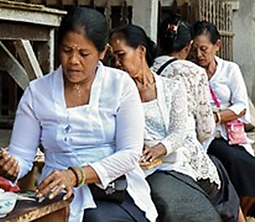
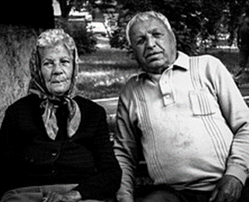
  Research problem
Latin American countries demographic changes entail challenges in terms of the social well-being of the population.
Two population groups are identified as vulnerable in the called crisis of care:
WOMEN
Offer care
ELDERLY POPULATION
Demand care
Notes:
The research problem Latin American countries demographic changes entail challenges in terms of the social well-being of the population.
Two population groups are identified as vulnerable in the called crisis of care: WOMEN
Offer care

Slide 3
  Research problem
Work is recognized as a channel for the satisfaction of human needs.
In the Colombian context, work is a social relation that configures the link to social protection.
How people relate to work expresses underlying power relations in society.
Political analysis of the work of women and the elderly population.

Slide 4
Hypothesis
Work as a social power relation reveals a set of systematic exclusions that make up one of the factors in the ageing process and discrimination against women.

Slide 5
Objectives
To present a brief reflection on the concept of work and its gender biases.
To propose an analytical approach to show the social relations between the target population and the work.
To build empirical evidence with the most recent figures to identify the job profiles of the target population.
To carry out an analysis of the systematic differentials (discriminations) operating in the target population.

Slide 6
Objective 1: Work concept
FEMINIST ECONOMICS
Neoclassical
Marginalist
Latin American perspective
Marx
Smith

Slide 7
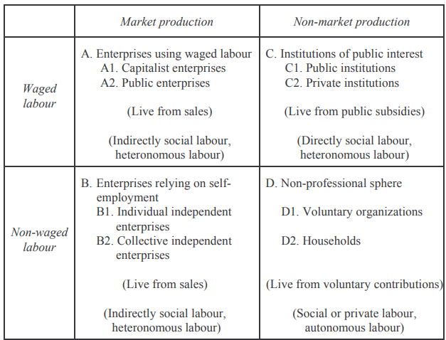
Objective 2: Analytical proposal
Classification of activities and production units
29,7%
3,2%
38,3 %
28,8%
Source: The foundations of capitalist economy, Jacques_Gouverneur, 2005

Slide 8
Considering that "work" is defined as:
“Any activity carried out for the production of goods and services that meet human needs and that is capable of being carried out by another person obtaining the same result” Margaret G. Reid 1986
And from Gouverneur's work and production matrix.
Work as a dimension of well-being is a social relation that gives rise to social inequalities between women and men. Changes in the form of bonding are also evident as age increases.

Slide 9
Objective 3: Empirical evidence
Indicator design
Sample: 250.000 households, 1 million people surveyed. Probabilistic, multi-stage sampling
Metodology
Sex and age: decennial groups. Reflect ageing as a process and a concrete age of life
Integrated Household Survey Colombia
Descriptive statistics
Population
Thematic
Total working time, Educational level, Income and poverty, Relationship and Social protection

Slide 10
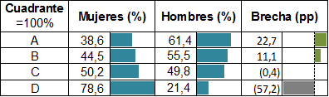
Objective 3: Empirical evidence
Percentage distribution of the working population within the quadrants by sex, 2015.
Source: Author, based on information from GEIH- DANE 2015

Slide 11
Objective 3: Empirical evidence
Percentage distribution of the working population within age groups, by item, 2015
Source: Author, based on information from GEIH- DANE 2015

Slide 12
Objective 3: Empirical evidence
Average weekly working time by quadrant, sex and age group
Source: Author, based on information from GEIH- DANE 2015

Slide 13
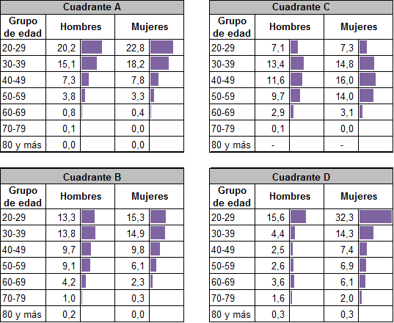
Objective 3: Empirical evidence
Composition (%) of working people with higher educational level
Source: Author, based on information from GEIH- DANE 2015

Slide 14
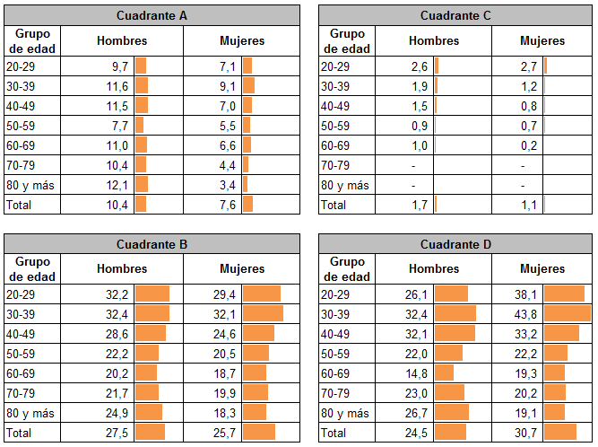
Objective 3: Empirical evidence
Incidence of poverty by age group, sex and item
Source: Author, based on information from GEIH- DANE 2015

Slide 15
Conclusions
The decisions of not linking women to the labor market, are conditional on the needs of consumption of care services within families, family responsibilities are an expression of the commitments socially assigned to women and collectively naturalized as typically female roles .
Total working hours for women is higher than that for men, it is evident that the total weekly work time of women in quadrant B between the ages of 20 and 39, has an average intensity between 81 and 82 hours

Slide 16
Conclusions
Poverty was concentrated among people not linked to the productive process as wage earners (9.3%), i. e. , in the self-employed population (26.7%) and those who worked mainly in domestic work and unpaid care.
The processes of age discrimination in relation to work, in women begin after the age of 39, while in men after the age of 49, ages that do not account for the traditional indicators for the study of aging.

Slide 17
Recommendations
Recognize and make it visible in the design of public policies, the unequal power relations that discriminate against women and against the population as age increases.
Advance in terms of economic measurement in a way that reconsiders traditional schemes of analysis, recognizes what are the social disadvantages of being women and older adults, exploring theoretical perspectives, such as feminist economics.

Slide 18
Recommendations
To work as a civil society, society, academy and state in construction of a National Care System that allows the reduction, redistribution and recognition of unpaid care work.
Evaluate in-depth the dimensions of the imbalance in the supply and demand of care, considering that this imbalance should not only be addressed as a public health problem but also as a multidimensional problem that encompasses different spheres: labor, cultural, educational, among others.

Slide 19
Thanks !
Andrea Paola García Ruiz
Economist, Master in Latin American Political Studies
Universidad Nacional de Colombia
apgarciar@unal.edu.co
September, 2019

