Slide 1
Prospects for Gender-Sensitive Macroeconomic Modelling For Policy Analysis in Colombia: Integrating the Care Economy
Mieke Meurs, Maria Floro, Ana Maria Tribin, Stephan Lefebvre

Slide 2
What are we talking about?
We are going to start giving you an overview of what is known about the paid and unpaid care economy in Colombia
We propose the development of a gender-sensitive macroeconomic model, focused on the care economy, suitable for policy analysis in Colombia. ( We need to gather information for this model.)
Such a model would strength the capacity of researchers, advocacy groups, policy makers, and government agencies to advance care in the national policy agenda.

Slide 3
What do we learn from analysing care in Colombia?
The Colombia Time Use Survey, administered in 2012 and 2016, provides the most comprehensive look at care work nationally, but has several limitations.
    It is not possible to identify the beneficiaries of such activities as cooking, cleaning, etc. (indirect care), and thus impossible to quantify the true burden of care for children, the elderly, and the disabled.
    the CTUS to date has not followed a time-diary format, leading to imprecise and misleading statistics, including observations where the total number of hours reported is different from 24 hours for a full day, although future surveys are likely to do so.
    Finally, the range of information collected from domestic workers and paid care givers in the household is very limited, with no information provided on passive care (e.g. minding children while completing other tasks) leading to underestimation of the amount of time spent in caregiving

Slide 4
What do we learn from analysing care in Colombia?
There is relatively more data available about unpaid care work compared to paid care work, and relatively more data available about childcare relative to elder care or care for individuals with disabilities.
There is a significant information gap with regards to how ordinary families meet their care needs by combining paid and unpaid care work.
Macroeconomic models that incorporate gender, including Computable General Equilibrium (CGE) models, can be used to estimate how changes in the care economy such as increasing the public provisioning of care may affect female labor supply, fiscal outcomes (via the tax and pension contributions of employed women), labor force productivity, economic growth, poverty, and the distribution of income.
Notes:
A typical family with a child under five years old, or a frail elderly relative, or a person with disabilities who requires assistance, will combine unpaid family labor, contracted services in-home and without, and assistance from government programs. No existing survey collects information from families about these inter-related arrangements.
Similar models are currently being developed for other countries e.g. South Korea. In the Colombian context, interviews with stakeholders from government agencies, advocacy groups, service providers, and labor unions indicate that a comprehensive policy analysis tool is needed in order to help design and promote gender justice-enhancing policies around the care economy.

Slide 5
The Care Economy Law of 2010 and Data Collection and Use
In 2010, Colombia passed the first law of its kind in the region, referred to as the “Care Economy Law” or Law 1413, which mandates the measurement of the care economy through a national time use survey.
the survey asks about both active and passive care of children under five years of age, including detail about how many hours were spent in paid care and at home, and about the identity (roster ID number) of the care providers.
The module asks about health problems and disabilities of each individual family member and records the household ID number of each individual who provides elderly, sick and disabled members with care.
In addition, the CTUS provides information on the number of hours of contracted care for children and other household members.
Notes:
Mandates that the Presidential Commission on Gender Equality coordinate a working group with the participation of government entities, academia and civil society, with the objective of supporting the implementation of the CTUS.
Directs “the Finance Ministry, the National Planning Ministry, the Central Bank, the National Budget Office, the Comptroller General, and any other government entity that participates in the preparation, implementation, and monitoring of the government budget and the study of the national economy… to include unpaid housework as part of their analyses on economic development of the country.”

Slide 6
Actividades no comprendidas en el SCN
Participation (%) in activities not included in the SNA, by sex and functionality
National total
Fuente: DANE - ENUT
Notes:
DESPROPORCION EN EL USO DE TIEMPO EN TRABAJO NO REMUNERADO DE LAS MUJERES

Slide 7
Actividades no comprendidas en el SCN
Tiempo (hh:mm) en las actividades no comprendidas en el SCN, por sexo y funcionalidad
Total nacional
Fuente: DANE - ENUT

Slide 8
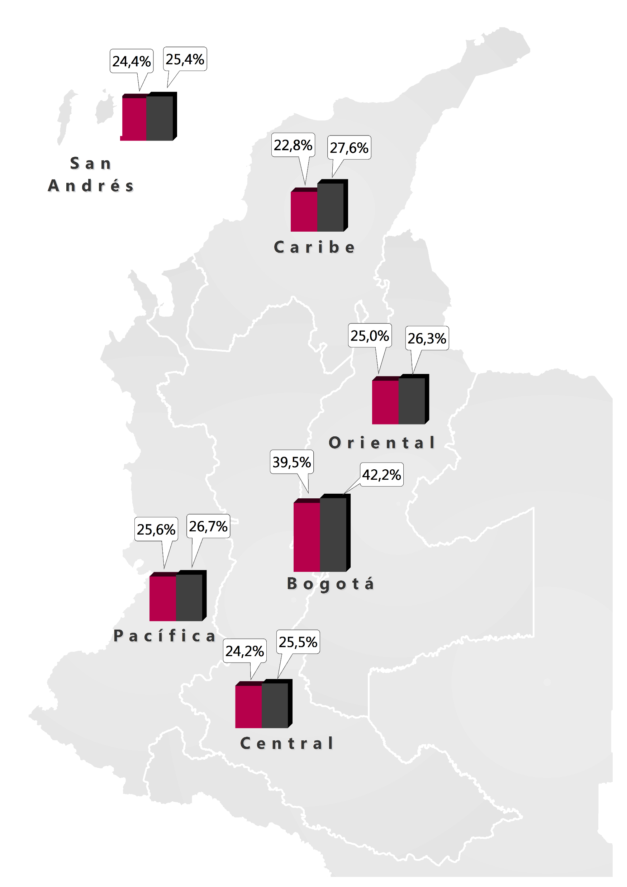
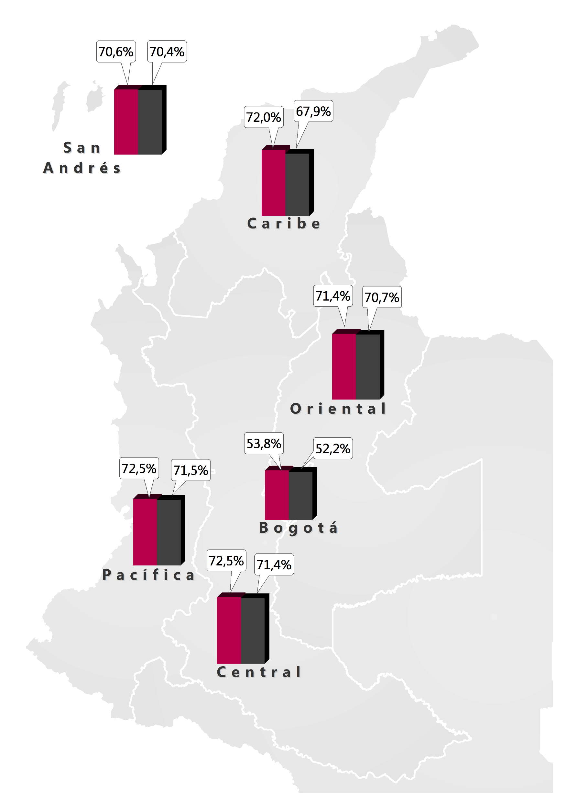
“Las mujeres son mejores para el trabajo doméstico que los hombres.”
^{Regiones}
Mujeres
Hombres
^{En desacuerdo}
^{De acuerdo}
Fuente: DANE - ENUT
Notes:
PERSEPCIONES QUE PREVIENEN QUE LAS MUJERES TENGAN ASPIRACIONES

Slide 9
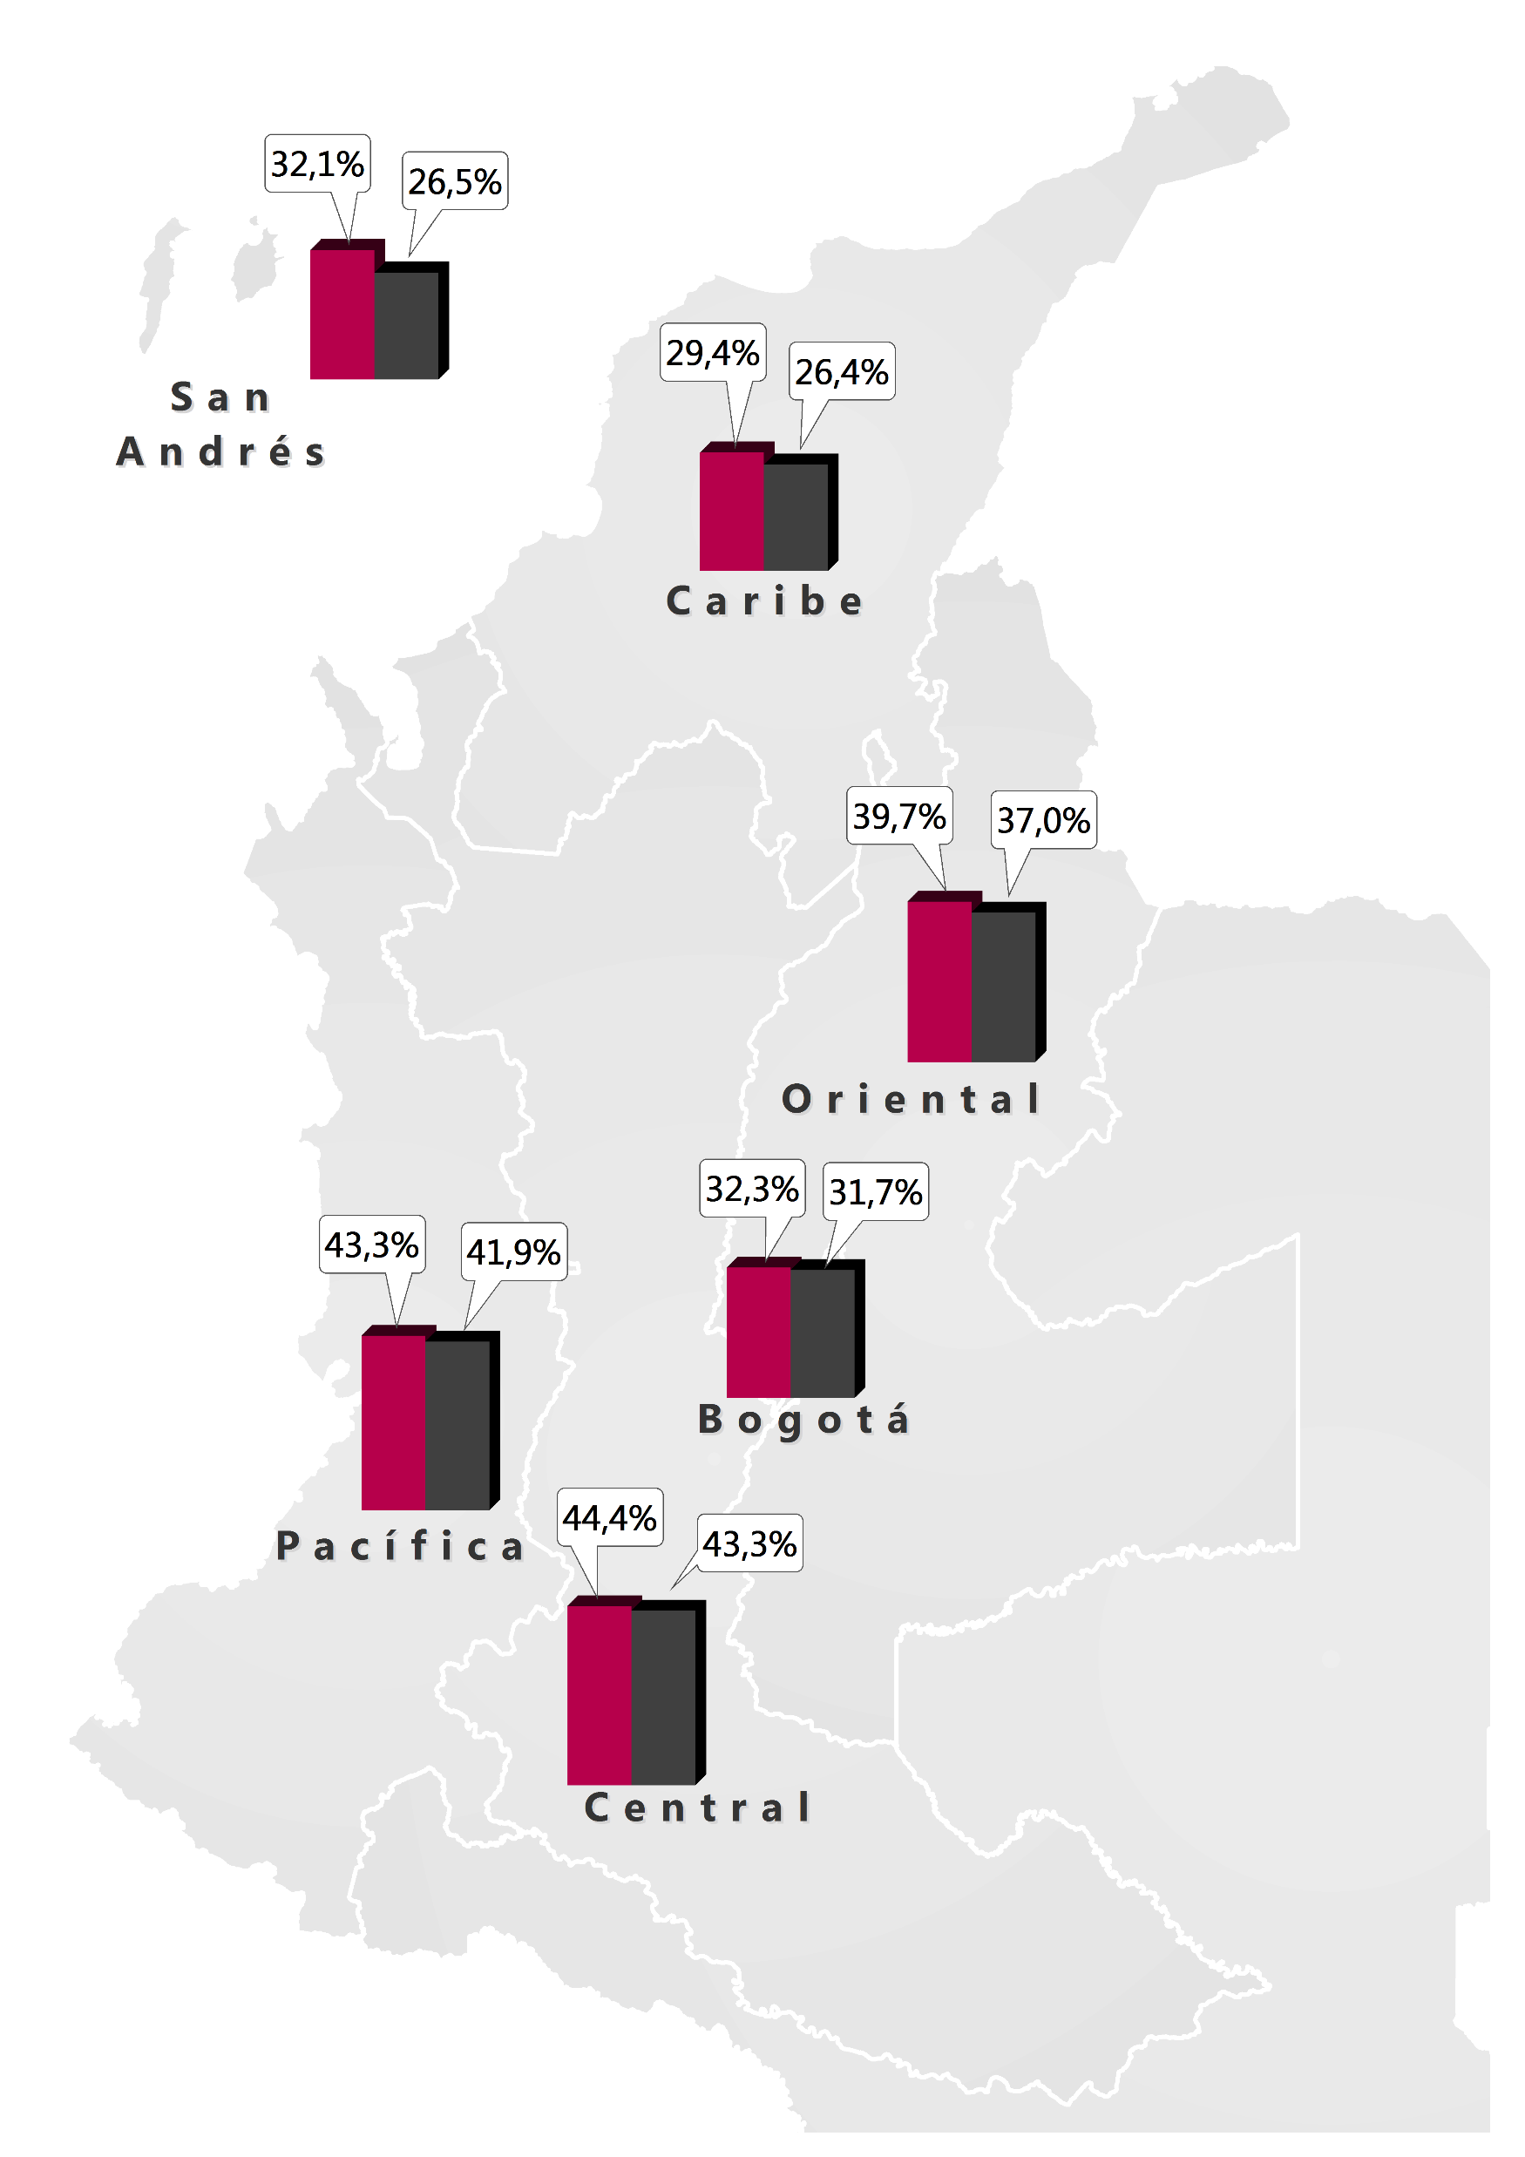
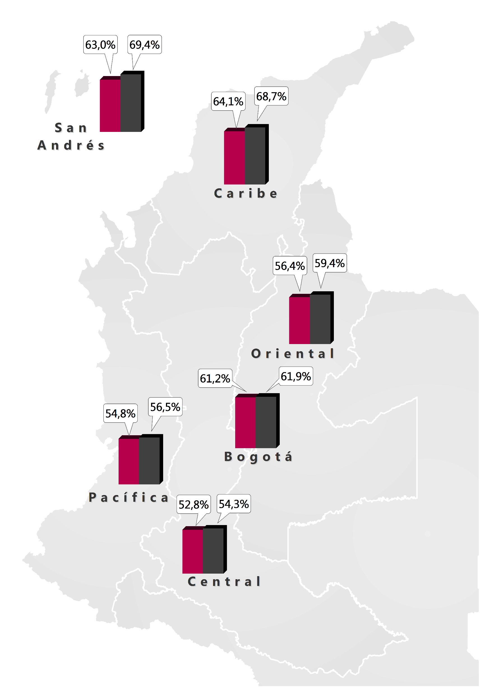
“Una madre que trabaja puede formar una relación tan cálida y segura con sus hijos como una madre que no trabaja”
^{Regiones}
Mujeres
Hombres
^{En desacuerdo}
^{De acuerdo}
Fuente: DANE - ENUT

Slide 10
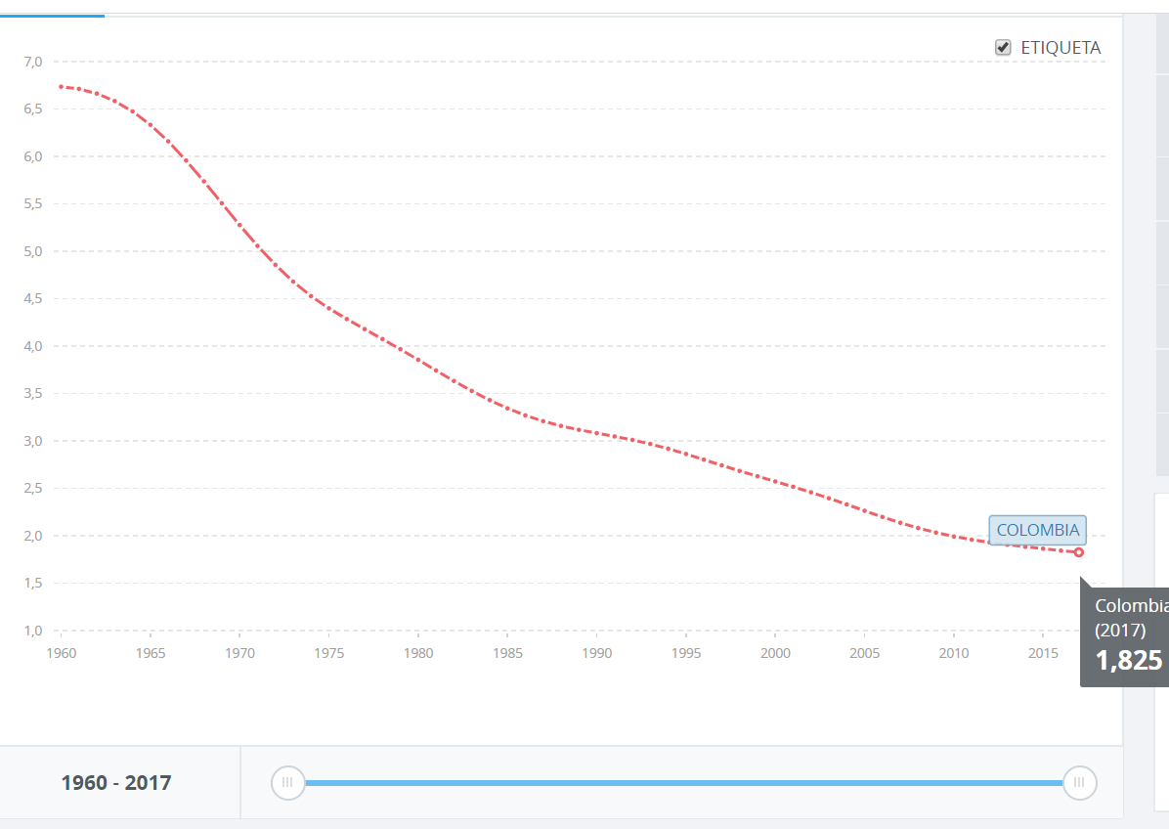
What is happening with Colombia?
According to the most recent report of Migration Colombia, in Colombia there are a total of 1'408.055 Venezuelans of which 742,390 have the papers in order to remain Colombia and 665,665 are in an irregular situation. Of this group of migrants 48% are women and 52% are men. 40% of the Venezuelan population in Colombia are in the age range of 18 to 29 years, followed by 25% of ages between 30 and 39 years. In 2018 there were born 425 babies from a Venezuelan mother.

Slide 11
Which ones are the next steps?
The National Administrative Department of Statistics (DANE) in Colombia began to develop an extensive set of gender-disaggregated data. To date, however, the existing statistics have not been used systematically in the design of macroeconomic and social policies.
Colombia has started to develop a policy on care. While DNP has developed some policy guidelines, they lack funding and support to “do the general equilibrium model or other types of model or instruments”
Current policy about the care economy promotes the idea that families can (and should) find their own solutions to care responsibilities.
While the participation of civil society organizations has been a prominent feature of labor and social policies in Colombia, this has not been the case with the design of the care economy law.
Notes:
This approach ignores the emerging statistical evidence that families need more government support to provide care to their family members, and to free women to participate in the labor market, earn income, contribute to pensions and develop professionally.. It ignores possible benefits of a system of care in which people trained for this task assume it daily, promoting harmony between unpaid and paid care work for the women and men.
Although there has been some consultation between civil society organizations and the DNP, the perspectives of many stakeholders, including domestic workers and low-income working women have not been incorporated into the policy guidelines developed by DNP. Nevertheless it is in a process of redesign.

Slide 12
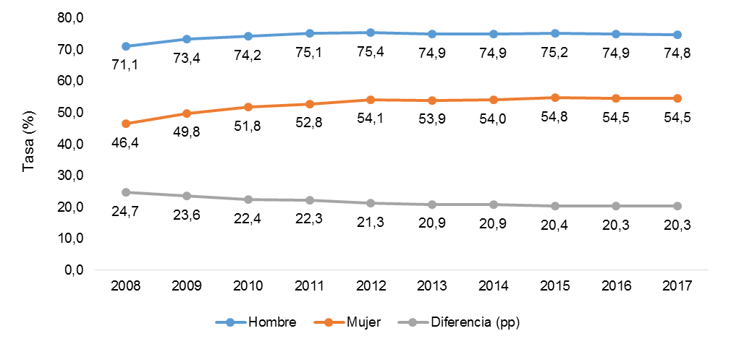
Unpaid Care Sector
In Colombia, unpaid care work is overwhelmingly done by women. This overrepresentation of women in unpaid care work—and the overrepresentation of men in paid work—is a finding repeated in every study done on unpaid care work in Colombia. Osorio Pérez and Lucia Tangarife (2015) estimate that women's unpaid care work in Colombia is equivalent to 16.3% of GDP in 2012, while that of men is equivalent to 4.1%. Care burdens contribute to the gap between men and women in labor market outcomes.
The dramatic increase in women’s paid work was not accompanied by a significant increase in men’s unpaid work. The result has been a double burden, or double-day, for women.
Fonseca 2018
Notes:
Villamizar García-Herreros (2011) reports a

Slide 13
Unpaid Care Sector
DIF RICH/ POOR: heavy female burden, with average weekly hours dedicated to household chores reported as 16 hours for poor households and 13 hours for non-poor households. Mejía and Olarte Delgado (2015, 135) show that unpaid work hours for women decrease with income, all else equal, because of differential access to paid care and also differential access to labor-saving appliances.
CHILD LABOR: The disproportionate burden falls not only on women, but also on girls.17.3 percent of girls ages 12 to 17 range reported doing housework for more hours than they were at school, while the same statistic for boys was 7.8 percent (Holguín Higuita and Medina Hernández 2015)
DIF RUR/URB: Hincapié Aldana and Parra García (2015) find that the 56.4% of urban women not officially in the labor force report doing 6 or more hours of all types of unpaid work, while 66.9 % of rural women do that much unpaid work. While rural women and urban women work about the same number of total hours, a larger proportion of those hours are unpaid for rural women (Peña and Uribe 2013).
Notes:
Villamizar García-Herreros (2011) reports a

Slide 14
Unpaid Care Sector
DIF EDUCATION: Those women with higher education work more outside the home than women with less education, but time spent on care does not change much. Women in poor households provide much of the care themselves, while those in affluent households rely heavily on domestic workers, supplemented by paid care in medical facilities, private daycare centers, and nursing facilities.
Notes:
Later research on unpaid care work is almost exclusively based on the CTUS. Using this data, Osorio Pérez and Lucia Tangarife (2015) find that unpaid care burden is much greater for women than men, and that it is quite consistent across women with different levels of education (Figure 1). Those women with higher education work more outside the home than women with less education, but time spent on care does not change much. In total, Osorio Pérez and Tangarife (2015) estimate that women's unpaid care work in Colombia is equivalent to 16.3% of GDP in 2012, while that of men is equivalent to 4.1%.
Women in poor households provide much of the care themselves, while those in affluent households rely heavily on domestic workers, supplemented by paid care in medical facilities, private daycare centers, and nursing facilities.

Slide 15
Child Care Sector
Urdinola and Tovar (2018), using the CTUS, show that direct unpaid care focuses mainly on children under five years of age, and that women spend four times as much time as men caring for children of this age. Care in the home may include some paid care by domestics and nannies, and this may be difficult to separate from unpaid care by household members.
Data suggest that both men and women spend little time caring for older adults (under 1 hour per week)

Slide 16
Child Care Sector
The CTUS asks about hours in paid care by contracted employees in the home, but passive and even direct care provided by a domestic hired mainly for another purpose (house keeper, for example) may not be reported.
If both the mother or grandmother and a domestic worker are at home, it may not be clear how to allocate the passive “minding.”
Interviews or participant observation with household domestic workers are needed to understand how to best use the existing data to estimate unpaid family care in these situations.

Slide 17
Child Care Sector
the Quality of Life Survey does not collect data on hours in various types of care, but instead asks about the type of usual care for every child under five (Mateo Díaz and Rodriguez-Chamussey, 2013).
The most comprehensive analysis of child care use data from this survey (Peña-Parga and Glassman 2004). Using 2003 ECV data, the study indicates that 54% of children under the age of five were usually cared for by parents and 12% of children under five were usually cared for by non-parent individuals, which may include a mix of unpaid care by, for example, grandparents, and paid care by neighbors or friends (but not formal paid care).

Slide 18
Care of the elderly
According to DANE projections for 2018, the population over 60 years of age in Colombia is expected to be around 5.9 million people, which represents approximately 12% of the Colombian population. 13% of this population suffers some type of disability, which makes them more likely to need special care.
Pineda (2014) shows that coverage for subsidized assistance in Bogota is 7.6% for people over 65 and 21.5% for people over age 75. This leaves families responsible for support; and as a result reportedly about 90% of elder care takes place in private homes (Friedemann-Sánchez, interview, 2018).
Notes:
Still, the CTUS data suggest that both men and women spend little time caring for older adults (under 1 hour per week) (Figure 3) (Urdinola and Tovar, 2018). This may result from analyzing only the time reported directly in care of older adults which, as noted above, includes only feeding, bathing, accompanying, conversing with, helping to administer medicine and “passive minding,” but is not suitable for estimating time in cooking, laundry and cleaning related to elder care. Caregiving is deeply embedded in social norms regarding gender roles that some respondents may not even consider some caregiving tasks as work activities per se, but merely a part of their responsibility and may therefore fail to report it. While the CTUS does ask about time in activities for members of other households, including time specifically in elder care, it is not always is not possible to determine who is the recipient of this care.

Slide 19
Care of the elderly
the CTUS data suggest that both men and women spend little time caring for older adults (Urdinola and Tovar, 2018).
This may result from analyzing only the time reported directly in care of older adults which, as noted above, includes only feeding, bathing, accompanying, conversing with, helping to administer medicine and “passive minding,” but is not suitable for estimating time in cooking, laundry and cleaning related to elder care.
While the CTUS does ask about time in activities for members of other households, including time specifically in elder care, it is not always is not possible to determine who is the recipient of this care.
Notes:
Still, the CTUS data suggest that both men and women spend little time caring for older adults (under 1 hour per week) (Figure 3) (Urdinola and Tovar, 2018). This may result from analyzing only the time reported directly in care of older adults which, as noted above, includes only feeding, bathing, accompanying, conversing with, helping to administer medicine and “passive minding,” but is not suitable for estimating time in cooking, laundry and cleaning related to elder care. Caregiving is deeply embedded in social norms regarding gender roles that some respondents may not even consider some caregiving tasks as work activities per se, but merely a part of their responsibility and may therefore fail to report it. While the CTUS does ask about time in activities for members of other households, including time specifically in elder care, it is not always is not possible to determine who is the recipient of this care.

Slide 20
One alternative source of data on elder care is the small National Study on Health, Welfare, and Ageing, a survey of 1,141 family caregivers in both rural and urban areas conducted in 2015. According to this survey, 83.9% of caregivers are women, their average age is 49, but 16.7% are over 60 years of age themselves. This survey suggests that 76% of caregivers of elderly live with the older adult they care for, again highlighting the need to collect information on care provided to individuals in other households (perhaps living alone).
the majority of caregivers are the offspring of caregivers (61%). The main care activities reported are helping with daily living tasks such as shopping, visiting the doctor, and administering medication, activities captured by the CTUS;
  12.5% are in charge of specialized care such as catheter handling.
  Two-thirds of caregivers are simultaneously employed in other jobs.
  Half of the male care providers were employed, while women caregivers mainly also did domestic work. 7
  7% of caregivers receive some salary, reward, or financial support for their care (Ministry of Health, 2015), and Friedemann-Sánchez reports that one example of such a reward is living rent-free in the caregiver’s parent’s house (2012a).
Notes:
. Entrepreneurship based at home, such as handicrafts or home-based child care centers, is encouraged as employment for women to facilitate combining paid work with care. Members of the Members of the Feminist Economics Roundtable point out that this gender ideology ignores the difficulties faced by many households in meeting the care demands, exacerbated by the aging population and legacy of the conflict which left many wounded and disabled, especially among the low-income and vulnerable segments of the population (Interviews, July 2018).
Interviews in both Bogota and Medellin.
Interviews with Antioqian Cultural Association and City of Medellin Women’s Secretariat.

Slide 21
Care of population with disabilities
The armed conflict lasting more than 50 years increased the number of people living with disabilities in Colombia. Pérez and Tangarife (2015) note that data on this population, its characteristics, and who cares for this group is unreliable and often missing.
According to Pérez and Tangarife (2015), this population is equivalent to approximately 2.5 million people, most of whom are over 60 and thus overlap with those needing elder care (Correa-Montoya and Castro-Martínez, 2016). However, the Colombian Constitutional Court provides a higher estimate--15% of the population is disabled, equivalent to 7.2 million people with disabilities (Correa-Montoya and Castro-Martínez, 2016).
Notes:
Time spent on the care of sick and handicapped people is available in the CTUS for the same activities as for elder household members--feeding, bathing, accompanying, conversing with, helping to administer medicine and “passive minding,” but not cooking, laundry and cleaning specifically associated with care of disabled or handicapped household members. It appears that, to date, no work has been done using this data to estimate unpaid time use for sick and disabled care. As was the case with elder care, additional information on unpaid time spent in care of sick and disabled people in Colombia might also be drawn from the CTUS by using the questions on which household members need care and who provides it, and that this information might be used both to validate (or not) the data on time in direct care, as well as provide information on how to improve the collection of data on unpaid sick and disabled care. As with elder care, participant observation and interviews/focus groups is needed to improve data collection on sick and disabled care.

Slide 22
In addition to data from the CTUS, information on unpaid care of disabled and chronically ill persons comes from the Registry for the Location and Characterization of Persons with Disabilities (RLCPD). In 2010, 37% of such registered persons required permanent assistance from another person to carry out daily activities (Gómez and Gonzalez, 2010).
Most of this assistance takes the form of unpaid labor--83.7% of the people who assist them are members of the household, suggesting a potentially heavy household burden. Another 3.6% are non-employed outsiders, and 1.9% are other persons, while 4.6% are specialized persons hired to perform these tasks.
According to the Registry data, 75% of caregivers are women, 15.3% are men(Gómez & González, 2010).
Notes:
. While the CTUS asks specific questions about a wide range of unpaid care and other household activities, the survey is highly structured, and is not open ended in such a way as to capture all possible activities (Peña and Uribe 2013, 21). Further, a time-diary format has not been employed in the 2012 and 2016 surveys, so individual responses may not be accurate as they are not constrained to add up to 24 hours per day (and 168 hours per week), although currently there is a plan to move to diary-format collection of the data in the next survey.
The context variables, which point to recipients of care, are critical for understanding intra-household transfers of time, but gaps remain. The survey records each family member’s relationship with the head of household but not the kin relationship between each individual in the household. I think that one can derive the latter from the information about member's relation th household head.
Where paid caregivers are present in the home at the same time as unpaid caregivers, it is unclear how to distribute passive care between paid and unpaid caregivers. Further, paid domestic workers may contribute to care even when they are not specifically hired to provide care, and this contribution may not be measured with the current survey instrument, which asks only about individuals hired to provide care.
Field work, including interviews, pilot survey, focus groups, and possibly participant observation, may contribute to a better understanding of patterns of care giving and thus better survey design. In addition, better use can be made of current data.

Slide 23
Limitations
Diary questions
The relationship between care giver and recipient may not be known.
time in cooking, laundry and cleaning for children and elders is not possible to calculate.
paid domestic workers may contribute to care even when they are not specifically hired to provide care, and this contribution may not be measured with the current survey instrument, which asks only about individuals hired to provide care.
Notes:
. While the CTUS asks specific questions about a wide range of unpaid care and other household activities, the survey is highly structured, and is not open ended in such a way as to capture all possible activities (Peña and Uribe 2013, 21). Further, a time-diary format has not been employed in the 2012 and 2016 surveys, so individual responses may not be accurate as they are not constrained to add up to 24 hours per day (and 168 hours per week), although currently there is a plan to move to diary-format collection of the data in the next survey.
The context variables, which point to recipients of care, are critical for understanding intra-household transfers of time, but gaps remain. The survey records each family member’s relationship with the head of household but not the kin relationship between each individual in the household. I think that one can derive the latter from the information about member's relation th household head.
Where paid caregivers are present in the home at the same time as unpaid caregivers, it is unclear how to distribute passive care between paid and unpaid caregivers. Further, paid domestic workers may contribute to care even when they are not specifically hired to provide care, and this contribution may not be measured with the current survey instrument, which asks only about individuals hired to provide care.
Field work, including interviews, pilot survey, focus groups, and possibly participant observation, may contribute to a better understanding of patterns of care giving and thus better survey design. In addition, better use can be made of current data.

Slide 24
Paid Care Sector: child care
The paid care sector is complex and is managed by many different entities including the central government, local governments, and diverse agents in the private sector
Bernal (2014) reports that in 2014 in Colombia there were nearly 3.2 million children under five years of age, and that the Colombian government estimates that 2.4 million of these children are in conditions of socio-economic vulnerability.
Congress passed a law in 2016 called From Zero to Forever that institutionalized a comprehensive state policy for early childhood development. Two types of institutions: institutional and community
Notes:
Coverage

Slide 25
Paid Care Sector: child care
The institutional centers provided specialized care of children under 6 years of age, including early education and nutrition, in an 8-hour day, caring for 236,145 children in 2014. This program also includes some centers run by trained community personnel, which offer somewhat more flexible hours (Perotti, 2000).
The community program modality offers the largest program, Community Mothers (MC). The MC offer a home-based childcare program using local resources, to provide both care and basic needs, including nutrition, health, protection, and psychosocial development of children.

Slide 26
Paid Care Sector: child care
The central government initiatives are supplemented by other centers. Local governments may provide childcare/ kindergarten /preschool for children under six years of age, as is the case in the capital city, sometimes competing with central government programs. There are also private preschools and daycare centers (Peña-Parga and Glassman, 2004, and paid in-home care givers (domestics, nannies).
According to the ECV 2011, 17% of children under three were cared for in centers, but 58% of children three to five years old (Mateo and Rodriguez-Chamussey, 2015).
A later and alternative measure of overall paid care use by children five and under comes from Bernal (2014), who uses data from the Colombian Longitudinal Survey of the University of the Andes (2010 and 2013), a nationally representative longitudinal survey. She shows that paid care for children aged 0-5 increased from 43% to 53% between 2010 and 2013, indicating that the new policy helped increase coverage by approximately 300,000 children
Notes:
Bernal et al. (2009) argue that both coverage and quality of MCs are low, however, especially in rural areas, where coverage is only one-third of that in urban areas. Since 2014, community mothers are government employees who earn minimum wages and social benefits, which may help to raise quality of care in the MC

Slide 27
Paid Care Sector: child care
Paid childcare can also occur in the home, provided by both nannies, directly contracted to provide childcare, and other domestic workers who may be combining childcare with other activities.
While data on care by contracted individuals is available in the CTUS, information on care provided by multitasking domestic workers will need to be collected

Slide 28
Paid Care Sector: Elder care
To date, the national government does not have any comprehensive policy on the care of elderly people. In addition, there do not appear to be any nationally representative large household surveys/data sets that include questions on this issue.
Since 2004, two types of institutions for adult care (Senior Citizen Welfare Centers and Day Centers) are run by non-profit institutions through agreements with municipal governments. But the supply is inadequate, and there are often long waiting lists. In Bogota, a visit to a center revealed that vulnerable elders can only go once a week to a daycare facility. The local government maintains that they want most of the care to be done by the family

Slide 29
Paid Care Sector: Elder care
Two government programs address to the needs of the elder population in situations of extreme poverty.
The program of Social Protection for the Elderly (PPSAM) consists of an economic subsidy in cash and/or in social services (accommodation, food, and health).
The National Program of Food for the Elderly provides supplementary food by means of a lunch 250 days a year to 400,000 elderly adults in conditions of extreme economic and social vulnerability (Salvador, 2007).
The presence of these two institutions is insufficient, as it is people in urban areas and major cities who have the greatest access to them. Vulnerable people living in rural areas have little access.

Slide 30
Paid Care Sector: Elder care
In some cases, paid care of elders is done by domestic workers, as noted above. The CTUS provides data on whether a contracted worker provides care for an individual elder household member, but no information on the amount of time provided and the type of activities performed by domestic workers are collected

Slide 31
Paid Care Sector: care for people with disabilities
Data on paid care for disabled persons in Colombia is currently very limited.
There is a directory of institutions that provide care for the disabled (public and private institutions and non-governmental organizations at the national, departmental, and municipal levels) In addition to data on time use by domestic workers.
Children with disabilities rely heavily on unpaid care because, as Correa-Montoya and Castro-Martínez (2016) report, 90% of children with disabilities do not attend basic school, and only 27.4% of disabled children ages 6 to 11 have access to the education system.

Slide 32
Limitations
Data on paid care for elderly, sick and handicapped individuals is more limited. The CTUS collects data on specialized domestic (“contracted”) workers who provide such care, but there appear to be no surveys that collect data on the use of government or private care programs, either part time or residential.
Institutional enrollment data may be available for government run programs, but it is not likely to provide a complete picture of time spent in paid care.
A related issue is the working conditions of paid care givers. For this sector to develop in Colombia, working conditions will need to be improved and regulated. Collecting additional data on this issue is important when expanding supply

