Slide 1
Work, life and the Colombian Migrant in Britain: An approach beyond Human Capital
Maria Fernanda Quintero O

Slide 2
High skilled migrant research generally utilizes human capital theory to explain how individual attributes of migrants affect their labour market outcomes (Ho, 2006).
Usually quantitative methods are applied to demonstrate that skill has a key role in employment prospects for international migrants because the more skilled the worker, the greater her(is) productivity. A productive worker will have better job and mobility in the labour market (Becker, 1993; Mincer, 1993).
There are concerns about the fairness of employment opportunities available to migrants in host economies. Some studies suggest that migrants experience significant discrimination on the grounds of their actual or perceived color, religion or origin (Taran, 2005). Usually evident in exclusion in employment process (ILO, 2004; Bendick, 1995; Bovenkerk, Gras, & Ramsoedh,1995; Colectivo, 1996; Goldberg, Mourinho, & Kulke, 1996; Smeesters & Nayer, 1999)
There is a relative absence of interdisciplinary research on migration: There is research from the labour market perspective➔ focus on wages but leaves transitions of career (Junankar et al., 2004)
Research on job market segmentation and migrants' occupational adjustment in host countries (Waldinger, Bozorgmehr, Lim, & Finkel, 1998)➔ leaves challenges in the process (of occupational adjustment)

Slide 3
Legal access usually focuses on the type of permit used upon arrival but statistics fail to track migration patterns as migrants can hope from one permit to other and can move back and forth from home countries or different countries.
High skilled migrant research generally utilizes human capital theory to explain how individual attributes of migrants affect their labour market outcomes (Ho, 2006).
For long, the US held the monopoly of attracting the highly skilled, but in the last years, countries as Canada, Australia and the UK have designed policies to attract “the best and the brightest”
In opposition to the common assumption that highly qualified migrants are an elite group protected by their human capital from the worst effects of discrimination, studies inform that factors such as gender, ethnicity, class, language, occupation and country of origin are sometimes penalised in the labour market (Heath and Cheung, 2006; and Healy and Oikeleme 2011).
Are highly skilled visas indeed more likely to be linked to an occupation which reflects migrant’s education, skills and high levels of productivity? Can these results be explained from a gender perspective?

Slide 4
About Colombians in the UK
The 2011 census classifies Colombia as Latin America’s second largest country of origin in the UK, with Brazil being the largest (McIlwaine and Bunge 2013). To be more precise, from the 144,470 Latin Americans that were recorded in England and Wales in 2011, a little over 25,000 were Colombians.
Latin American migrants often seen as ‘invisible’ (McIlwaine, 2005; Wills et al, 2010)
Highly qualified at the point of migration (McIlwaine, 2005; Guarnizo, 2008)
Existing studies find that Latin Americans are a socially disadvantaged group that often work in low paid jobs and precarious conditions (McIlwaine, 2005)
Choice of Britain as a destination not linked to British colonialism but more likely to Spanish colonialism
Colombians may be disproportionately viewed with hostility by the Border Agency
Existing research not sought to understand the differences within the Colombian migrant group

Slide 5
Methodology
A mixed methods approach:
An online survey run in 2013 n=210 BUT uneven reply to question (potentially influenced by ethics approval of survey)
Gathered data about sociodemographic characteristics
Academic characteristics
Migratory trajectory including legal statuses
Social networks influence and transnational practices
Labour market trajectories
In-depth interviews with 13 Colombians in London (4 men and 9 women) and 6 in Glasgow (3 women and 3 men)
(mostly out of the survey: 105 expressed willingness to participate in follow up interviews)

Slide 6
Characteristics of sample
 | n | % | N=
Male Female | 75 135 | 36 64 | 210
Estrato 1-2 3 4 5-6 | 3 36 51 80 | 2 21 30 47 | 170
Age 21-30 31-40 41-50 | 65 119 20 | 31 57 10 | 209
Degree qualification+ - On migration: - while in Britain: | 146 136 | 70 66 | 210 206
Currently in paid work | 158 | 80 | 198

Slide 7
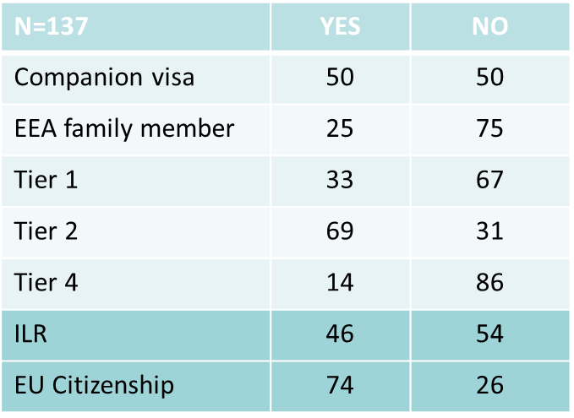
P1: Legal status will determine the confluence of education with positive occupation experience for both men and women
P2: Female Colombians will fare less well than their male counterparts
Does your current occupation reflect your level of education and skills? (Crosstabulation with current legal status)
Seems that Policy makers were right.
Sorting migrants by level of
Education yields to higher levels of
satisfaction (and then productivity)

Slide 8
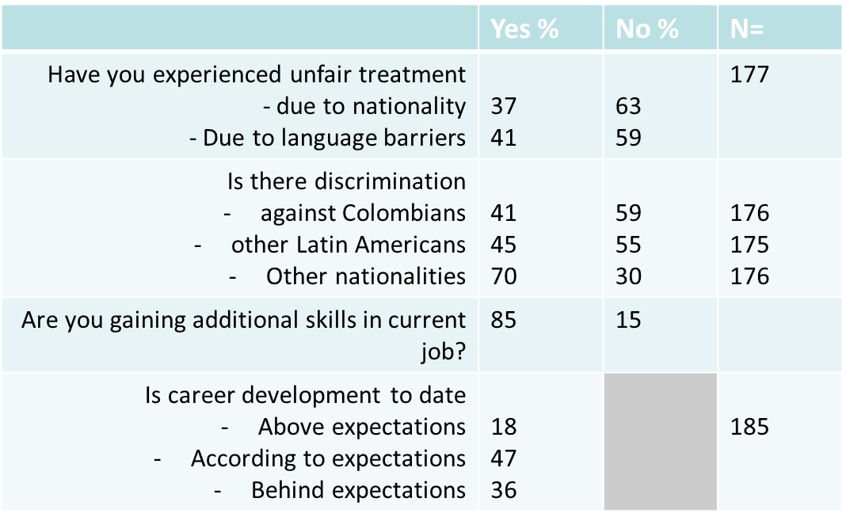
P1: Legal status will determine the confluence of education with positive occupation experience for both men and women

Slide 9
P2: Female Colombians will fare less well than their male counterparts
If the influence of Estrato level holds good post-migration, it may be that this sample of Colombian women are disadvantaged before migration
Male – 15 per cent consider themselves Estrato 1-3
Female – 27 per cent consider themselves Estrato 1-3
There would appear to be no significant gender difference regarding
unfair treatment due to nationality
unfair treatment due to language barriers
perception of discrimination
career development

Slide 10
Preliminary results at this regard:
Colombians are very self confident regarding their level of education and skill capacity to fulfill their tasks at work (men a bit more than women but difference not significant)
89% women and 77% men agreed to be gaining skills in their current jobs. However, when asked about their current job mirroring their level of education, the response is very polarized as half of them agrees and the other half disagrees.
When asked about their perception of fulfilment in their career development, positive perceptions seem to stand out over negative ones, almost equally in men than in women (65%). Yet, (35%) Colombians feel their career development is below their expectations and they are likely to report that this is due to sex
Notes:
2:This means that some of their current jobs can be of lower skilled level than the level of skills they possess or at least they perceive they possess, but this doesn’t always make those jobs less interesting, thus their responses represent a very positive view of people giving value to their individual learning process in the labour market.

Slide 11
Preliminary results at this regard:
On average, women’s annual gross income is lower than men’s (full time jobs). Half of them earn 25 thousand pounds and below… But there is at least a woman in the highest category of earnings (+65 thousand)
Despite lower earnings, almost half women (46%) stated to be satisfied, compared to 37% of males… Grateful slaves? Hakim (1991). So it seems. For instance Stella (ILR holder): “When I went to the interview at Barclays, I had an MBA, I had been looking for a job for 6 months, I was working as a barista with an MBA from this country! I almost begged them to give me the job, I told them I will clean the floors, I can start from scratch but give me the job!”
Some women and men reported to work unpaid extra hours in a regular bases. When asked about the satisfaction with the hours worked, women reported higher levels of satisfaction than men. Reasons might be more associated to other sort of benefits related to balancing motherhood and keeping a good job: “since I have been there I have had 3 pay rises, not good ones(…) I don't think another company would give me as much flexibility, like being a senior and being able to progress with flexibility. That's why I stay there.”
Notes:
3. This perception reminds us that moving away from basic jobs not necessarily implies a positive change (McIlwaine 201x). Therefore, in order to further support answers about their perceptions in the British labour market, we asked Colombians how their current job would most likely be if they were working in Colombia. Although close to 35% men and women responded not to know the answer to this question, 41% women and 46% men stated their job would most likely be better than the one they currently have.

Slide 12
Gracias!

