Slide 1
Determinant factors of the criminality of women in Medellin: a spatial analysis.
Nataly Rendón González - Juan Carlos Duque.
Universidad EIA - Universidad Eafit

Slide 2
Dual problem:
Increase participation in criminal activities for feminine liberalization: Beaton, Kidd and Machin (2018).
Greater participation in educational, political, and economic scenarios in which women have also had power roles allows them to acquire greater skills and therefore decreases the incentives to participate in criminal activities.
1
Crime studies have turned their attention to male crime:
Lack of data, because they hide in the fact that the illicit activity coming from men is much greater (Yugueros, 2013).
The types of crimes committed by women are less serious (Beaton, Kidd and Machin, 2018; Sánchez, 2004; Realpe and Serrano, 2016).
The interests, knowledge, needs and tastes of men can be generalized for all humanity, leaving out the details of female behavior, both the good and the bad. The aforementioned point includes criminal conduct as well. Fuller (2007),

Slide 3
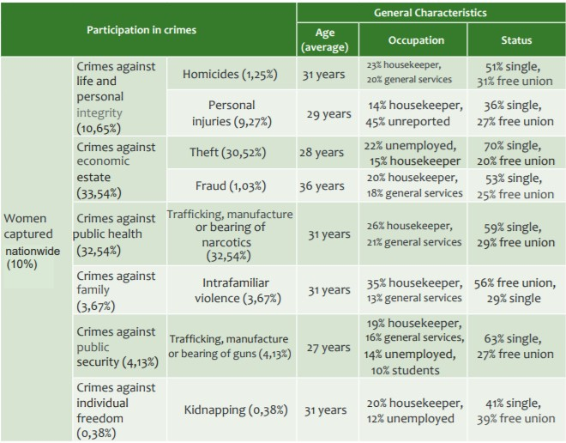
The rate of women deprived of liberty in Latin America has increased, from 2000 to 2017, by 53%.
Colombia: Norza-Céspedes et al.(2012).
2

Slide 4
Medellín:
Historical scenarios:
In particular, reference is made to the rise in violence associated with the phenomenon of drug trafficking and hired killers (1985-1991).
The creation of gangs and militias in the city, as well as the strengthening of guerrilla and paramilitary presence in the city (1991 - 2005).
The failure of the war urbanization strategy that generated an increase in homicides in the city due to the demobilization of the Cacique Nutibara and Héroes de Granada blocks between 2005 and 2008.
Finally, in the last decade the increase in criminal gangs, extortion in various markets of the city and an important re-emergence of criminal structures is evident.
3

Slide 5
Medellín:
Dávila (2016)

Slide 6
Methodology
A spatial econometric model whose dependent variable is the homicide rate per 100,000 inhabitants in the city of Medellin, explained by socioeconomic and demographic variables presented by the SISC (Information System for Security and Coexistence) and DANE.
Following Patiño et al. (2014), the work will collect some socioeconomic and demographic variables of Medellín for the analysis:
4
Variable | Expected relationship
Men between 20 and 24 years old | +
Unemployment | +
Poverty levels | -
Housekeeper | +
Education | -
Thef | +
Drugs | +

Slide 7
Some questions:
¿It is necesary a “criminal” policy that take account the differences in gender? (Stylized facts )
¿Are there other social factors that may explain female criminality? (Sociological and psychological literature)
¿The care policy in Colombia may reduce the increasing in the female crime?

