Slide 1
The dilemma of having it all: gender inequalities at the labor market of highly educated in Argentina
Natalia Escobar-Váquiro
FLACSO
Dissertation director: Corina Rodríguez-Enríquez

Slide 2
Research problem
Social: women who "decide" to have it all (superwomen)
Academic: feminist economics —gender inequalities in the labor market are based on the power relations that are given by the ideals of men and women that have been socially constructed—
Vacancy: gender inequalities on highly educated in Argentina
Research question:
How does it affect the ways of household provisioning in the generation of gender inequalities in the labor market of highly educated in Argentina in 1996, 2006 and 2016?

Slide 3
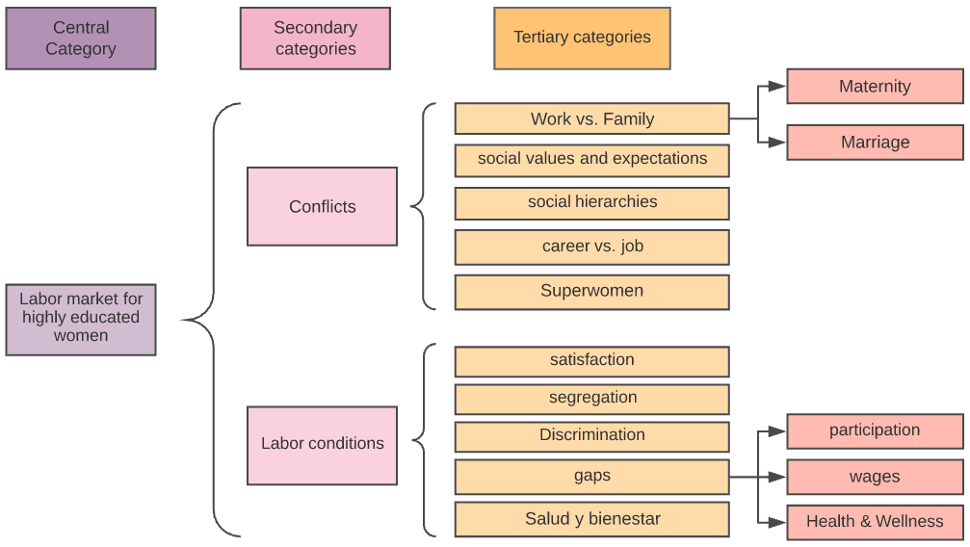
Literature review

Slide 4
Three sources of data
EHP 1996, 2006, 2016
 | 1996 | 2006 | 2016
Mujeres | 389,107 | 716,773 | 1,079,102
Hombres | 457,354 | 608,030 | 823,414
% population | 4.7% | 6.0% | 7.5%
Semi-structured interviews: 35 people were interviewed, 20 women and 15 men
Ohlalá Magazine: “a qualified audience with high consumption capacity” [traduced from Spanish] with an average age of 30 years (La Nación)

Slide 5
Triangulation of methods
Quantitative techniques
Research scheme
Domestic unit
Gender
Labor market conditions
Individual characteristics
Objective of this research type
Macrosocial reconstruction of the structure from the individual units of analysis
Source: adaptation of Sautu et al. (2005)
Qualitative techniques
Semi-structured interviews: The call to interviews was made through snowball sampling.
The key dimensions for conducting the interviews were:
History and composition of their household
Choice of profession: segregation, family pressures, “rational” choice.
Conditions in the employment market: entry, segregation, discrimination, underemployment, unemployment.
Provisioning: labor inactivity, care and domesticity, family income.
Maternity/paternity: choice about life cycle, number of children.

Slide 6
Triangulation of methods
Qualitative techniques
Documentary analysis
Selection of the analysis object: Ohlalá Magazines editions
Pre-analysis development
Collect documents
Formulate analysis work guides
Set indicators
Definition of analysis units: in this case are gramatical based, words and phrases
Development of analysis rules: agreements between at least two experts of the conditions for coding and categorizing
Code Development: After segmenting and grouping according to the analysis rules, identifiers are obtained for each group.
Category Development: previously encoded content is definitely ordered
Final integration: entanglement between data collection, coding, categorization and final interpretation

Slide 7
Preliminary results
Strong relationship with market labor in worst labor conditions than men. Labor force participation 80%. The sexual division of labour is resilient
even for the most educated.
Question ¿quieren las mujeres realmente renunciar a ser las principales responsables del cuidado del hogar? (Agency)
«We made stipulations, splitting all tasks in half. For example, he is at home on Mondays, and I am free. On Tuesday, the same, only the other way around. But when I saw him buy new socks from the children or take them to the doctor, I collapsed. It is difficult to give up being a true mother, the only one who is really responsible for children and the house, the really important person, who counts…, sharing that role, instead of limiting that of a simple helper. ”(P. 64 ). Friedan, The second stage
There is similar process: Bradshaw, S., Chant, S., & Linneker, B. (2018). Challenges and Changes in Gendered Poverty: The Feminization , De-Feminization , and Re- Feminization of Poverty in Latin America. Feminist Economics, 25(1), 119–144.

Slide 8
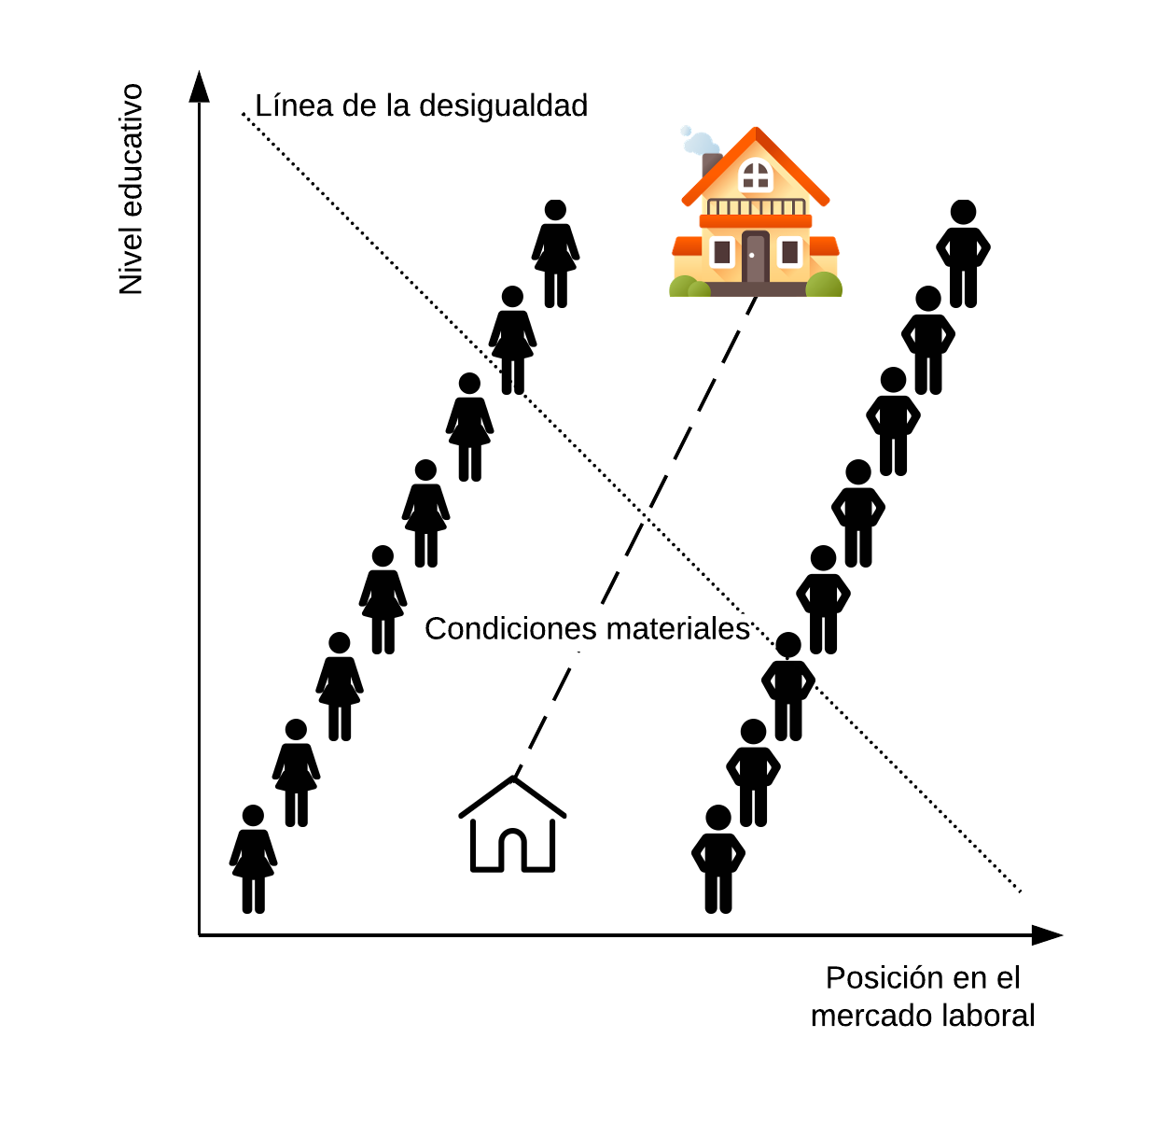
synthesis
The guilt for domestic work does not remain but for care work
other households put work intensively to support care and housework
there is a high component of distrust in the care that men do
most mothers would like to quit their job to take care of their childs (at least a few years) and most men think it is the ideal setting
men competed more for jobs of greater hierarchy
most believe in meritocracy, but they know that gender inequities exist
most believe that the ideal family model is a couple and that there is an inexplicable link between children and mother that is generated in a "magical" way

Slide 9
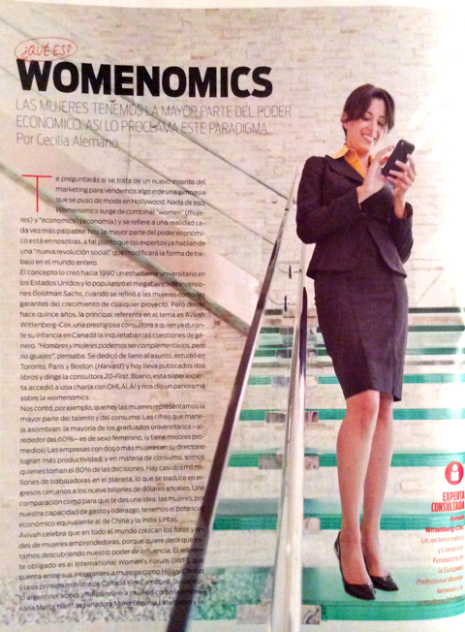
Notes:
"new paradigm" is proposed: womenomics that is based on the fact that women have the most economic power "new social revolution", this is because most of the university graduates say that they concentrate more talent and consume more, they make the companies more productive. Although it conceals —or does not seem to understand— that gender inequality is structural, that women do not have the economic power in the world and that the workplace continues to be a source of inequality. In this sense, the expert raises several feminine characteristics: a low profile, altruistic spirit, peaks of productivity after 40 years —when the children have already had—, sociable, receptive, multitasking, humble. In addition, he explains that companies to achieve this escalation of women in companies have had to achieve a "bilingual management" that speaks the female and male languages.

Slide 10
Gracias

