Slide 1
Effect of the wage gap on retirement age women’s
poverty risk
Martha Susana Jaimes
PhD Candidate Public and Urban Policy
The New School
Workshop Productivity, International Economy and Gender
October 8, 2019
Notes:
Thank you for inviting me. This is joint work with Teresa Ghilarducci, Michael Papadopoulos, and Wei Sun.

Slide 2
1. Motivation

Slide 3
Single Women, Widows, and a Lack of Retirement Security
Rates of elder poverty among single women (never married) and widows are higher than among couples and men.
Poverty among single women reflects low lifetime earnings and spotty pension coverage.
Poverty among widows results from the exhaustion of financial resources

Slide 4
Poverty in Retirement Age
Source: Author’s calculations using United State’s 2016 Current Population Survey (CPS)

Slide 5
Differential life expectancy
Women have higher life expectancy than men at all ages
Source: Social Security’s period life tables for 2017

Slide 6
Sources of Retirement Income in the United States
Private Savings
Pensions:
- Defined Benefits
- Defined Contribution
Social Security Old Age Insurance
Retired Worker benefits
Spousal benefits
Widows/widowers benefits

Slide 7
Social Security’s Old Age Insurance (OAI)
Highly regarded as the basic structure of the country’s welfare programs, Social Security’s design is what classifies the United States as “the least generous welfare state of any advanced industrial democracy (Huber and Stephens, 2001:p. 126)”
The Social Security’s structure as social insurance instead of welfare assistance situates the provision of social services and poverty relief as a solution to a market failure (unemployment or low savings)
Old age Social insurance is provided as poverty is considered an idividual risk

Slide 8
Social Security reforms affecting claim age
1935
Social Security Act Full Retirement Age at 65
1956
Amendments to SS Act Female workers and wives allowed to claim starting at 62
1961
Amendments to SS Act Early Age for male retirees lowered to 62
1972
Amendments to SS Act Delayed Retirement Credit –DRC- instituted as a fair compensation for delaying
1983 Amendments to SS Act Gradual increase of Full Retirement Age from age 65 to 66 (2003-2009) and to age 67 by 2027. DRC lowered from 72 to 70 starting 1984
Based on Knoll and Olsen (2014)

Slide 9
Actuarial Adjustments and Claiming behavior will impact Social Security retirement benefits

Slide 10
2. Research Question

Slide 11
My research question:
What is the impact of the United States’ current retirement structure on female old age poverty?
What are the determinants of female poverty risk in old age?
Gender gap
Life Expectancy
Wealth accumulation
Are the current rules for Social Security’s retired worker benefits contributing (or not) to female’s retirement security ?
M. Jaimes | June 26, 2019
Notes:
The U.S faces a retirement savings crisis. Over half of working age households will be unable to maintain their standard of living in retirement.

Slide 12
My hypothesis:
Women’s old age poverty risk is higher due to less bargaining power derived from the gendered distribution of paid and unpaid work, labor market inequalities, and interrupted work histories. This factors lead to reduced women’s retirement security by lowering access to retirement benefits (DB or DC accounts) and accrued income inequality reflects on both lower account balances and lower OAI Social Security benefits.
The relation between mortality risk, socioeconomic status and claiming behavior compromises the progressivity of the Social Security benefits formula.

Slide 13
3. Findings

Slide 14
The Gender Pay Gap in Retirement Resources Exceeds the Pay Gap
Author’s calculations using Bureau of Labor Statistics avg. weekly earnings 2017, Social Security average monthly benefit paid at FRA, Survey of Income and Program Participation data for 2014 .

Slide 15
Gender gaps in retirement age
These gaps result in women having lower average retirement income (relevant intersectional analysis).
The disparity in retirement income does not affect the poverty rate of married couples, which is calculated under the assumption of income pooling between spouses.
However, married women are exposed to the risk of substantial income declines upon divorce or the death of a husband.
Medical and funeral expenses can go up to 37% of annual income when spouse dies. (Fan and Zick, 2004)
Never married woman do not benefit from income pooling or Social Security spousal or widow’s benefits

Slide 16
Poverty Incidence in Retirement Age (Old Age, 65+) by gender and marital status
Source: Author’s calculations using United State’s 2016 Current Population Survey (CPS)

Slide 17
Probability of Married Women Outliving their husbands
78.2% of women in the cohorts 1931-1951 entered retirement as part of a married couple.
Most of these women will spend a considerable part of their retirement in widowhood
The average age difference with their husbands was 4.2 years
Assuming average population mortality for these cohorts, 64.2% will outlive their husbands by an average of 8.5 years.

Slide 18
Marital Status at Age 60 by Gender
Source: Author’s calculations using Health and Retirement Study Data for cohorts 1931-1951 using HRS sample weights.

Slide 19
Social Security retirement benefit gap
Disparities in poverty rates partly reflect the greater prevalence of widowhood among low socioeconomic status women.
Social Security benefit formula takes 35 years’ wage-indexed earnings as starting point. Women are more likely to interrupt work for child and elder (including husband) care, which leads to fewer years in the workforce and lower average earnings.
Were it not for the progressivity of the Social Security benefit formula, gender gap in SS benefits would be higher.

Slide 20
Social Security retirement benefit gap
Today, married women and men are entitled to three distinct types of Social Security benefits:
Benefits based on their own earnings records
Spousal benefits
Survivor benefits

Slide 21
Claiming behavior – HRS Participants in sample
Claim Age of Retired Worker Benefits (%)
Author’s calculations using HRS administrative data for cohorts 1929-1952

Slide 22
Percentage of Income from Social Security, by Marital Status

Slide 23
Defined Contribution Account Balances Gap
Men ages 55-64 have a median DC balance of $118,000 compared to $74,000 for women.
This gap does not reflect disparities in participation rates between men and women workers, which are identical.
Gap reflects women’s lower lifetime earnings and interrupted work histories.

Slide 24
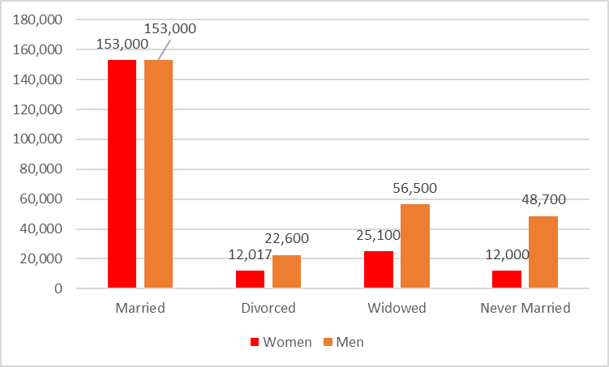
Median Non-Housing Wealth by Marital Status and Gender of Household Head at Age 65
Current $USD, 2014

Slide 25
3. Data

Slide 26
Data: Health and Retirement Study
Health and Retirement Study (HRS) data is a nationally representative longitudinal survey focused on the health status and retirement transitions of older Americans
The study interviews participants over age 50 and their spouses -nearly 23,000 households- a total of 39,000 individuals have entered the survey to date.
Interviews are done every two years since 1992 and constitutes the main national panel survey with information on retirement and health.
I use Social Security administrative data linked to HRS

Slide 27
Data: HRS Administrative Records
My study includes Health and Retirement Study (HRS) data for cohorts between 1892 and 1952
Administrative information:
Birth date
Death date
Type of benefits claimed
Age at which first benefits are claimed
MS. Jaimes | CRR – Boston College | 3 April, 2019

Slide 28
4. Methodology

Slide 29
Descriptive Analysis - Methodology
Calculation of age difference between married couples based on Social Security cohort life tables and HRS sample cohorts.
Age difference is calculated for married women born between 1931 and 1951, and their husbands. Using this information I estimate the probability of women outliving their husbands and the average number of years women will remain as widows.
Median Non-Housing Wealth based on gender of household head at age 65. Wealth defined as net value of non-housing wealth including real state other than equity in the primary residence.
My focus in this initial part of the study is on quantifying the relationship between claim age and subsequent mortality

Slide 30
Gompertz Survival Model and Probit Model
I estimate a Gompertz survival model to test mortality risk according to the claim age and socioeconomic status variables (race, gender, occupation, educational level, marital status)
The Gompertz is a parametric model commonly used in demography to analyze mortality rates in older ages.
Probit model associating claim age and SES variables to study determinants of poverty risk

Slide 31
Model
The Gompertz Model has a hazard function of the form:
The first parameter models the first moment, allowing covariates that influence the level of the hazard as follows:

Slide 32
RESULTS: Mortality Participants by Claim Age

Slide 33
Conclusions
The United States’ Retirement Crisis: In both cases women will benefit from policy reform that strengthens Social Security and creates Guaranteed Retirement Accounts (GRAs) as a source of independent retirement income lasting a lifetime
Proposals to strengthen Social Security to better meet the needs of higher poverty risk groups range from applying incremental changes to the rules for spousal and survival benefits to creating a universal minimum benefit.
Policy Note: https://www.economicpolicyresearch.org/jobs-report/old-age-poverty-single-women-and-widows-and-a-lack-of-retirement-security

Slide 34
Thank you
Martha Susana Jaimes
msjaimes@newschool.edu
Notes:
I thank you for your time

