Slide 1
The impact of economic policy & structural change on gendered employment inequality in Latin America, 1990-2010
Elissa Braunstein, Colorado State University
Stephanie Seguino, University of Vermont

Slide 2
Background
The 2000s vs. the 1990s in Latin America
Higher growth rates
Household income inequality falls (but declining wage share)
Declines in poverty
A shift in macroeconomic and social policy
Increased social spending and minimum wage
Use of countercyclical policies
Improved terms of trade (TOT)
External finance cheaper with low interest rates
Management of exchange rates to promote competitivenss

Slide 3
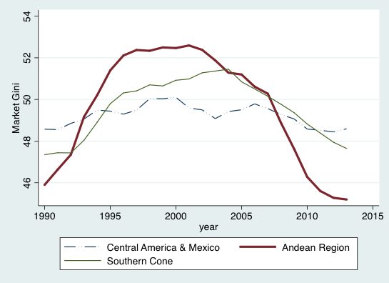
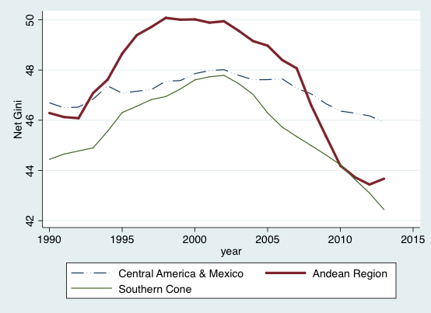
Market Gini
Net Gini

Slide 4
Did gender inequality also decline?
Absent data on the gender distribution of income, we focus on employment, a key aspect of gender equality.
Our question: How have changes in economic structure and policy affected gendered employment trends?
Our variables of interest:
F/M employment-to-population rate ratios
Separately, female and male employment-to-population rates

Slide 5
Why do we care about gender (in)equality?
Macro research finds positive effect of gender equality in employment on GDP growth.
Can raise productivity (by increasing investments in human capacities)
May produce positive demand-side effects

Slide 6
Female/Male Employment Rate Ratios in the 2000s vs. the 1990s
Employment: Low but increasing

Slide 7
Changes in women’s relative employment and net Gini, 1991–2013
Countries with largest decline in income equality saw greatest improvements in women’s relative employment.
But, low correlation between Gini and F/M emp in 2000s (0.04)

Slide 8
Econometric Analysis
Independent variables
Social & Employment Policy
Social public expenditures/GDP
Minimum wage/average monthly wage
Macro Policy
Real effective exchange rate (increases indicate depreciation)
Real interest rate (nominal lending rate – inflation)
Public investment/GDP
Industrial Structure
Manufacturing exports/manufacturing imports
Share of fuel & ores in exports
Terms of trade
GDP growth

Slide 9
Social & Employment Policy
Social spending increases can
reduce women’s unpaid labor burden
increase demand for female labor due to job segregation
DeHenau and Himmelweit (2016) and others find positive effect of social spending on women’s access to work
Minimum wage increases can
reduce employment, focusing only on cost aspect of wages
raise productivity (efficiency wage effect)
increase aggregate demand
Women may be more affected due to concentration in low-wage jobs

Slide 10
Macro Policy variables
REER – an increase (depreciation) promotes competitiveness
Real interest rate – inversely related to investment and GDP growth
Public investment – has direct and indirect effects
physical K investment increases demand for male labor
can also reduce women’s unpaid labor burden, increase their employment

Slide 11
Structure of production and Growth
Effects of these variables influenced by gender job segregation
Terms of Trade (net barter, Px/Pm)
rise with price booms for commodity exporters
may stimulate investment in extractive industries, leading to Dutch Disease
G revenue rises and possibly spending
Ratio of mfg X/M – rises as country moves up industrial ladder
May lead to defeminization of employment
Fuels and ores as % of merchandise exports
Male employment may rise but little emp. generated.
GDP growth – Two way causality with gendered employment.

Slide 12
Econometric analysis: Methodology
Panel data
OLS with fixed country effects
2SLS with GDP growth as endogenous
Instruments:
Gross fixed capital formation growth
Growth of average years of education

Slide 13
Employment Results
 | Female/Male |  | Female |  | Male
 | FE | 2SLS | FE | 2SLS | FE | 2SLS
Social policy: Boosts employment, especially women’s employment
social spdg | 0.21* | 0. 21* | 0.20* | 0.20* | -0.02 | -0.01
min/avg wage | 0.11** | 0.10* | 0.14* | 0.14* | 0.03* | 0.04*
REER | 0.12* | 0.13* | 0.10* | 0.11* | -0.02 | -0.02*
RIR | -0.0 | -0.0 | -0.0 | -0.0 | -0.0 | -0.0
Public Inv | 0.05* | 0.05* | 0.08* | 0.08* | 0.03* | 0.03*
Mfg X/M | 0.03 | 0.03 | 0.03 | 0.03 | -0.0 | -0.0
Fuel & ores | 0.04* | 0.04* | 0.03* | 0.03* | -0.0 | -0.0
TOT | -0.05 | -0.05 | -0.02 | -0.02 | 0.03 | 0.04
GDP growth | -0.0 | -0.0 | -0.0 | -0.0 | 0.001* | 0.0

Slide 14
Employment Results
 | Female/Male |  | Female |  | Male
 | FE | 2SLS | FE | 2SLS | FE | 2SLS
Social policy: Boosts employment, especially women’s employment
social spdg | 0.21* | 0. 21* | 0.20* | 0.20* | -0.02 | -0.01
min/avg wage | 0.11** | 0.10* | 0.14* | 0.14* | 0.03* | 0.04*
Macro policy: Strongest results on public investment, which increase both women & men’s employment
REER | 0.12* | 0.13* | 0.10* | 0.11* | -0.02 | -0.02*
RIR | -0.0 | -0.0 | -0.0 | -0.0 | -0.0 | -0.0
Public Inv | 0.05* | 0.05* | 0.08* | 0.08* | 0.03* | 0.03*
Mfg X/M | 0.03 | 0.03 | 0.03 | 0.03 | -0.0 | -0.0
Fuel & ores | 0.04* | 0.04* | 0.03* | 0.03* | -0.0 | -0.0
TOT | -0.05 | -0.05 | -0.02 | -0.02 | 0.03 | 0.04
GDP growth | -0.0 | -0.0 | -0.0 | -0.0 | 0.001* | 0.0

Slide 15
Employment Results
 | Female/Male |  | Female |  | Male
 | FE | 2SLS | FE | 2SLS | FE | 2SLS
Social policy: Boosts employment, especially women’s employment
social spdg | 0.21* | 0. 21* | 0.20* | 0.20* | -0.02 | -0.01
min/avg wage | 0.11** | 0.10* | 0.14* | 0.14* | 0.03* | 0.04*
Macro policy: Strongest results on public investment, which increase both women & men’s employment
REER | 0.12* | 0.13* | 0.10* | 0.11* | -0.02 | -0.02*
RIR | -0.0 | -0.0 | -0.0 | -0.0 | -0.0 | -0.0
Public Inv | 0.05* | 0.05* | 0.08* | 0.08* | 0.03* | 0.03*
Macro Structure: Fuel & ores seem good for women’s employment, but not clear why
Mfg X/M | 0.03 | 0.03 | 0.03 | 0.03 | -0.0 | -0.0
Fuel & ores | 0.04* | 0.04* | 0.03* | 0.03* | -0.0 | -0.0
TOT | -0.05 | -0.05 | -0.02 | -0.02 | 0.03 | 0.04
GDP growth | -0.0 | -0.0 | -0.0 | -0.0 | 0.001* | 0.0

Slide 16
Employment Results
 | Female/Male |  | Female |  | Male
 | FE | 2SLS | FE | 2SLS | FE | 2SLS
Social policy: Boosts employment, especially women’s employment
social spdg | 0.21* | 0. 21* | 0.20* | 0.20* | -0.02 | -0.01
min/avg wage | 0.11** | 0.10* | 0.14* | 0.14* | 0.03* | 0.04*
Macro policy: Strongest results on public investment, which incease both women & men’s employment
REER | 0.12* | 0.13* | 0.10* | 0.11* | -0.02 | -0.02*
RIR | -0.0 | -0.0 | -0.0 | -0.0 | -0.0 | -0.0
Public Inv | 0.05* | 0.05* | 0.08* | 0.08* | 0.03* | 0.03*
Macro Structure: Fuel & ores seem good for women’s employment, but not clear why
Mfg X/M | 0.03 | 0.03 | 0.03 | 0.03 | -0.0 | -0.0
Fuel & ores | 0.04* | 0.04* | 0.03* | 0.03* | -0.0 | -0.0
TOT | -0.05 | -0.05 | -0.02 | -0.02 | 0.03 | 0.04
Growth: Little effect
GDP growth | -0.0 | -0.0 | -0.0 | -0.0 | 0.001* | 0.0

Slide 17
Conclusions
Gender equalizing policies in the labor market
Social spending
Minimum wage increases
Parallels with literature on determinants of Gini, but our analysis highlights promising effects via employment channel
Macro policy and structural change
Public investment promotes gender equality
Competitive exchange rate promotes gender equality in employment
Positive effect of fuel & ores on gender equality but not Mfg X/M
In general, lack of employment-generating industrial policies
Focus on growth insufficient

