Slide 1
Determinants of Unpaid Domestic and Care Work in Colombia
Vanessa Ospina Cartagena
Departamento Nacional de Planeación
September 27, 2019

Slide 2
Motivation
Female global participation rate remains low
GPR
: March 2001: male 77,0% female 50,5% Gap: -26,5 pp
  March 2019: male 74,2% female 53,3% Gap: -21,0 pp

Slide 3
Motivation
Female global participation rate remains low
1. Female labor supply is tied to the time that women spend on household and care activities.
2. The decision to participate or not in the labor market is influenced by cultural factors that promote inequality in household chores.
3. Rural women are in the worst situation.
GPR in march 2019: 38.3%

Slide 4

Additional Ingredients
1. Demographic transition problem:
(BID: Over 60 years old in 2015: 10.8%; in 2050: 23.0%)
2. Labor market dynamics: high informality and low pension coverage
3. Traditional social protection system, especially in rural areas: families provide care services for elderly people.
These ingredients increase female pressure for parents care

Slide 5
Research question
What factors are determinants of participation and
time spent on unpaid work in Colombia?
Who stay in home and what they are doing when are in home?
We will identify what variables can be manipulated from public policies to increase female global participation in a care economy frame.
National Care System

Slide 6
Related literature
Macroeconomic Perspective
Account the contribution of the care economy in national income
Contribution of care economy to GDP in Colombia: i) Urdinola (1998) 17.2% ii) DANE(2019) 20.6%
Women contibute with 17.2%
How introduce gender variables in General equilibrium models
Theoretical models of recursive macroeconomics
Microeconomic Perspective
Theoretical models of time use distribution in households: Becker (1965), Folbre (2004)
Effects of time use on population welfare: Beaujo, R (2007)
Trends and determinants in time use: Sayer (2005), Gauthier et al. (2004)
Women are participating more in labor market but they don't leave household chores, they preferred sacrifice leisure time and created a “leisure gap”

Slide 7
Data
National Time Use Survey (ENUT for its Spanish acronym)
The ENUT is a cross-sectional survey conducted by the National Administrative Department of Statistics (DANE for its Spanish acronym), which collects information on the activities carried out in the last 24 hours.
The survey must be carried out by law every 3 years (Law 1413 of 2010)
The survey has been done twice: 2012-2013 and 2016-2017.
ENUT collects quantitative information on the total use of household time.
The latest version collected subjective information about the use of time

Slide 8
Some facts
Who is doing household chores?
Women do most of unpaid work.
Women between 25 to 34 years in rural areas

Slide 9
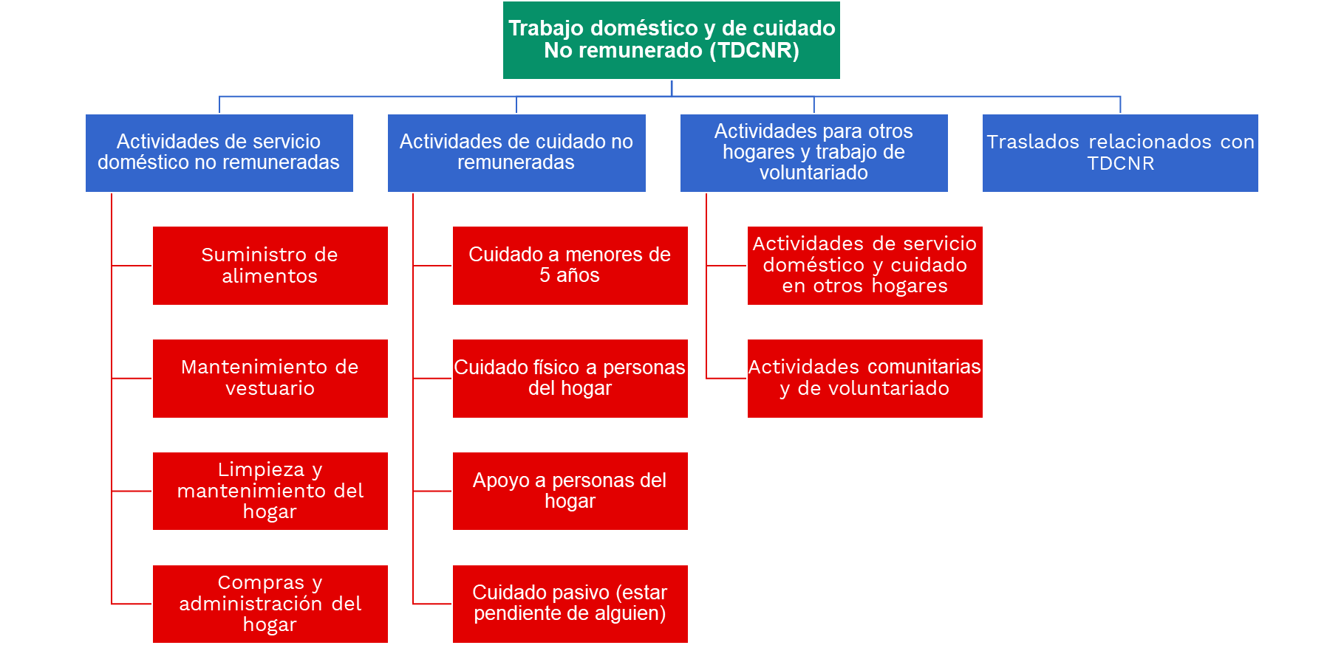

Slide 10
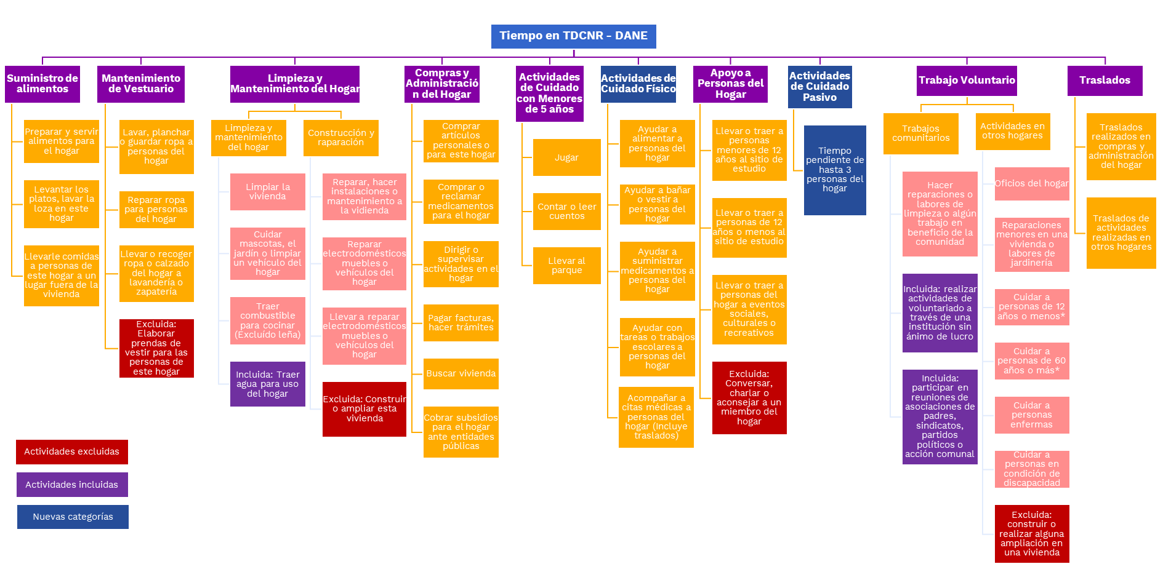

Slide 11
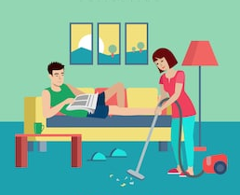
Some facts
Unpaid work: who does what?
2. Women perform most weekly hours of care and domestic work.
Men perform care tasks, especially passive care*, and volunteering.
Men do not do domestic activities.
*Be aware of someone, not necessarily in person.

Slide 12

Some facts
Who really works?
3. Women work more hours than men (paid and unpaid).
Employed women face a “double shift” (the increase in female participation was at the expense of less free time)

Slide 13
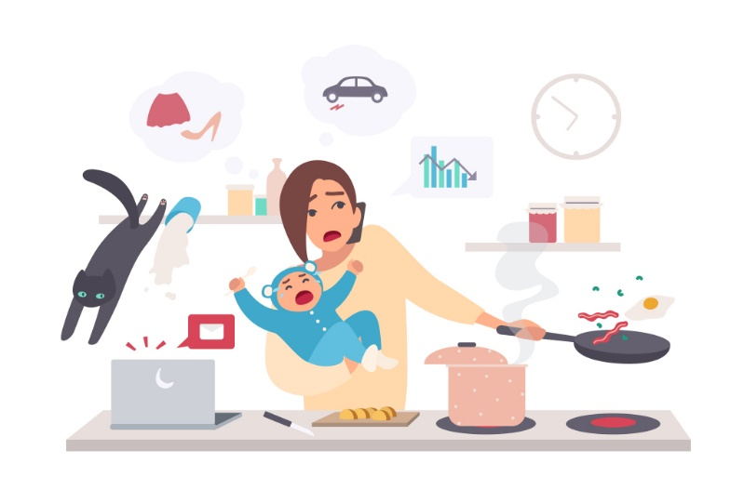
Some facts
Who takes care of the kids?
4. Women adjust their time when they have children.
Men stay almost the same.

Slide 14
Some facts
What do women think about this situation?
70% of women think they are doing their fair share at home.
Only 12% of women think they did not have time to do all their activities.

Slide 15
Methodology
Two ways
Did you cook yesterday?
No
Should I record your answer as a missing or as a zero data?
Zero
Missing
Censored model at zero.
Selection problem
Tobit: I can estimate a limited dependent variable model
Heckman: I can control for participation and answer both questions.

Slide 16
Methodology
Two ways
Hypothesis: care economy is a mirror of the labor market; this would mean that men can self-select to participate in household chores, and I only observe the average hours of those who participated.
Missing
Selection problem
Heckman: I can control for participation and answer both questions.
This mean that the time of women and men would not be comparable.
Problem: find a instrumental variable.

Slide 17


Variables
$Daily hours of unpaid work$ (ln) =
Sex (1=Woman) + Age + Rural/Urban + marital status + education in levels
+ Household Income (Quintile) + Unemployed + Inactive
Home with children under 6 years + Home with children between 7 and 14 years
Home with children between 15 and 17 years
+ Adult over 65 at home (inactive) + Elderly*Children
+ family typology
Home with Domestic Service + Region F.E.
+ Appliances index
+ Sexism index + Women who approve sexism (Sexism index*Sex)

Slide 18
Sexism Index (0% -100%)
Index Variables | Strongly disagree Disagree | (3) Agree (4) Strongly agree
A employed mother can form a relationship as warm and safe with her children as a mother who does not work. | +1
Both, men and women, should contribute to household income. | +1
A man's duty is to earn money, the woman's duty is take care of home and family. |  | +1
Women are better for domestic work than men. |  | +1
The husband must make decisions related to the wife's life. |  | +1
The head of the home must be the man. |  | +1
Sexism Index takes values between 0 and 6 (The index was normalized from 0 to 100)
Based on Guevara, K (2011)

Slide 19
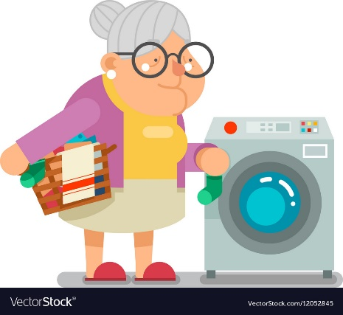
Appliances Index (0% -100%)
Index Variables | Home has this appliance
Máquina lavadora de ropa - washing machine | +1
Máquina secadora de ropa – dryer | +1
Horno eléctrico, a gas u horno microondas - Electric, gas or microwave oven | +1
Máquina lavadora de platos - Dishwasher machine | +1
Aspiradora/brilladora - Vacuum Cleaner | +1
Appliance index takes values between 1 and 5 (The index was normalized from 0 to 100)

Slide 20
Determinants of Unpaid Domestic and Care Work

Slide 21
Determinants of Unpaid Domestic and Care Work

Slide 22
Determinants of Unpaid Domestic and Care Work

Slide 23

Preliminary conclusions
Women participate more and spent more hours to unpaid domestic and care work compared to men (46.8% more hours in 2017)
Married and people in open union participate more and spend more hours (41.8% more and 39.0% more) in unpaid activities compared to single people.
Households with children under 6 years spend 39% more hours than households without children.

Slide 24

Preliminary conclusions
Women who approve machismo participate more and spend more hours than those who do not.
In particular, an increase of 1 pp in women sexism index, increases the unpaid work by 0.1% (A woman agree with all the statements spend 10% more hours per day in unpaid work)
Having appliances (which reduce time spent on domestic activities) is significant and negative in 2012-2013 and 2016-2017 (a 1% increase in appliances index decreases unpaid hours 0.2% per day (20% if the home have all appliances)).

Slide 25
Policy Recommendations
What do these preliminary results tell the National Care System?
The results of the machismo index show the importance of implementing public policies focused on cultural changes from school, especially in rural areas.
We need large institutional and regulatory changes that increase the participation of men in childcare (paternity leave, work permits for men, etc.)
The increase in care activities shows the importance of public care for early childhood, in extended hours, compatible with labor market hours, especially in the rural area.
In Colombia, the public offer of care for the elderly is very precarious and our population is aging without pension income.
We need to redefine which variables are part of care economy definition.

